Slide 1
SELECTIVITY OF MARINE FISH HARVESTING GEARS:
GENERAL THEORY, SIZE SELECTION EXPERIMENTS AND
DETERMINATION OF SIZE SELECTION CURVES
Joseph T. DeAlteris
University of Rhode Island
Kingston, RI

Slide 2
Gear selectivity is used to control size of fish susceptible to a fishing gear and the age of entry and exit from the fishery.

Slide 3
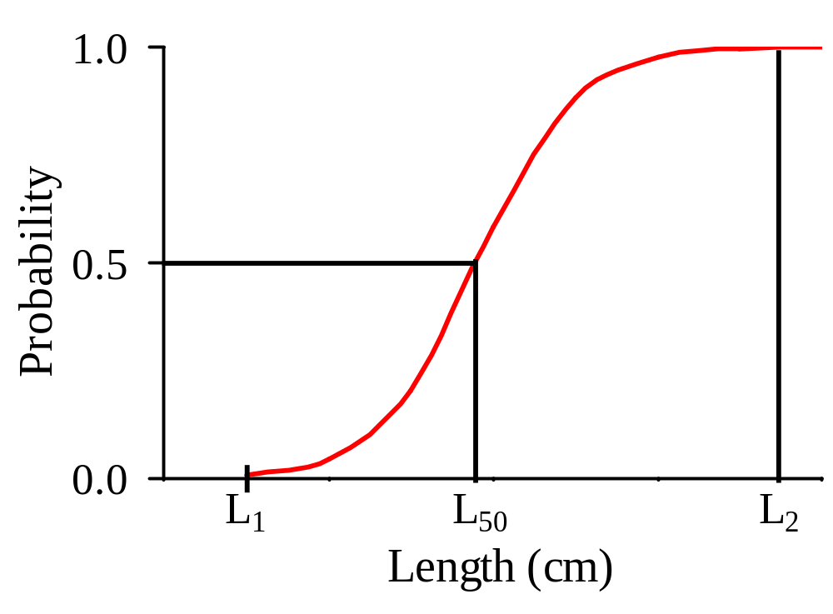
Types of Size Selection:
Sigmoid Shaped Curve

Slide 4
Characteristics of a Sigmoid Shaped Size Selection Curve
Represented by Logistic Cumulative Distribution Function (LCDF).
Fish smaller than L₁ are not captured (P = 0).
Fish larger than L₂ are captured (P = 1).
For a unique fish length, L₅₀, which is > L₁ but < L₂, there is 50% probability of capture (P = 0.5).
Typical of trawl gear and some traps and hook.

Slide 5
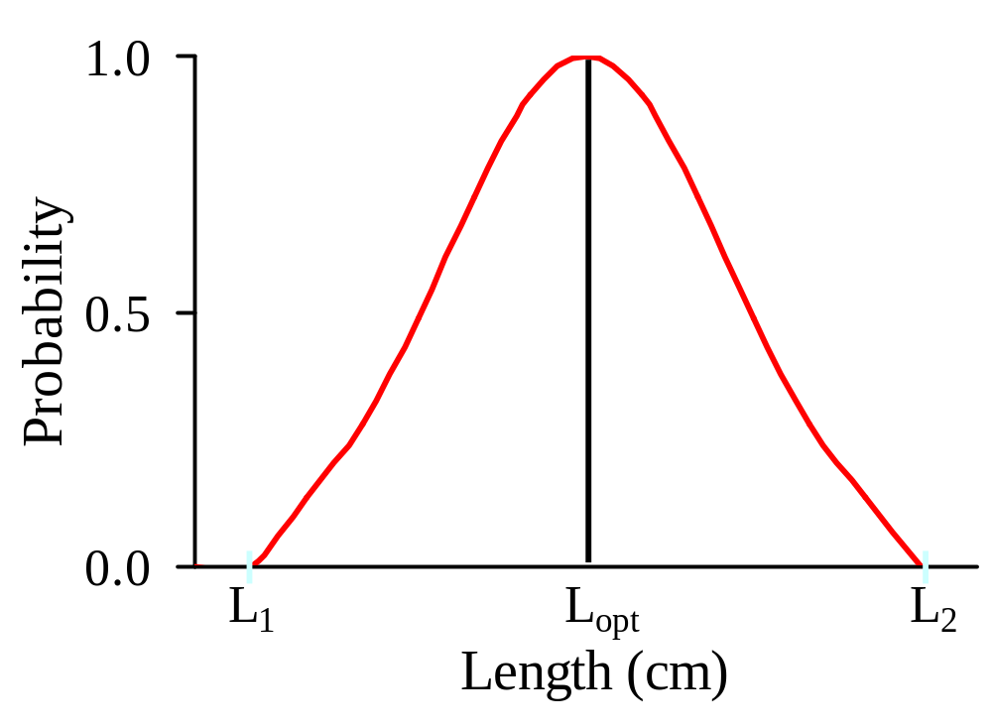
Types of Size Selection:
Dome Shaped Curve

Slide 6
Characteristics of a Dome Shaped Shaped Size Selection Curve
Represented by truncated, rescaled Normal Probability Density Function (NPDF).
Fish smaller than L₁ are not captured (P = 0).
Fish larger than L₂ are not captured (P = 0).
A certain size fish (L_{opt}), between L₁ and L₂ has a 100% probability (P = 1) of being captured, if encountering the gear.
Typical of gillnets, and some hook and traps.

Slide 7
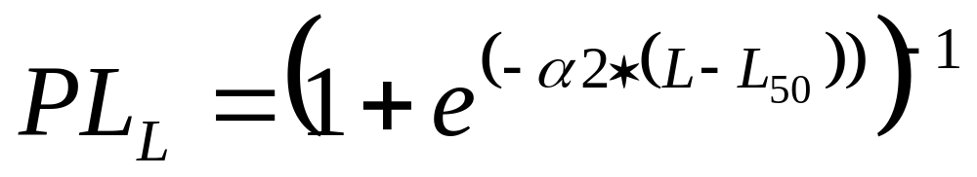
Logistic Cumulative Distribution Function (Specialized Form)
Where: PL_{L} is the probability of retention at length (L)
α2 is the steepness of the curve, and
L₅₀ is the length at 50% selection.

Slide 8
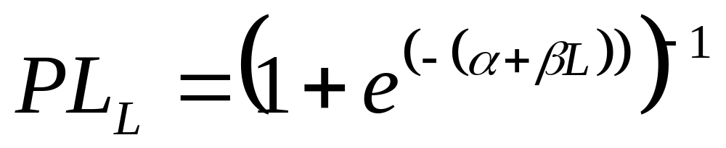
Logistic Cumulative Distribution Function (General Form)
Where: α is (-α 2 * L₅₀), or (-β * L₅₀), and
β is identical to α2, the steepness of the curve .

Slide 9
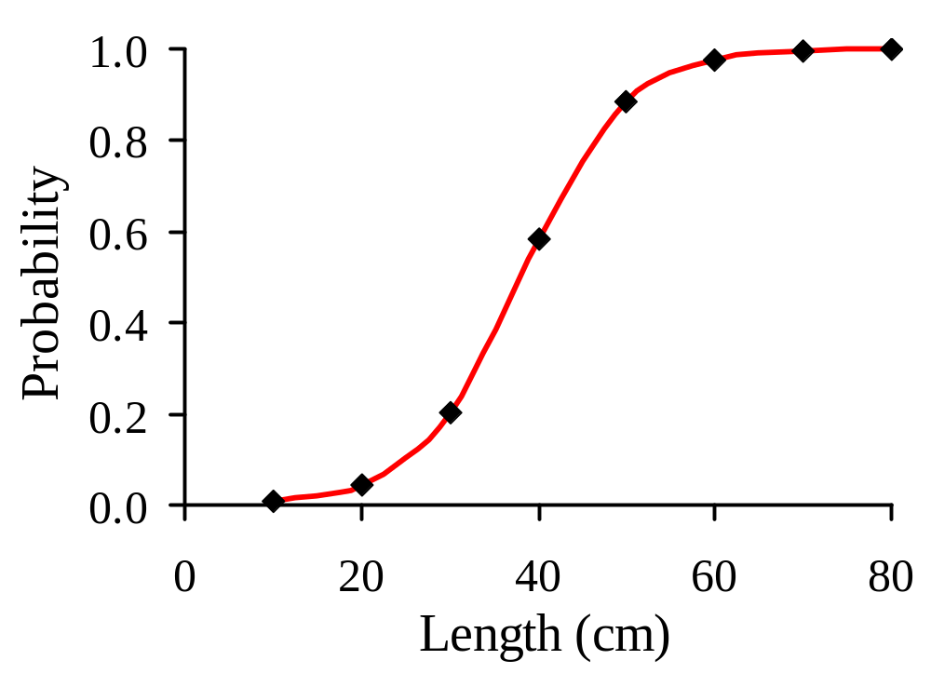
Probability of Selection Following a Logistic Cumulative Distribution Function

Slide 10

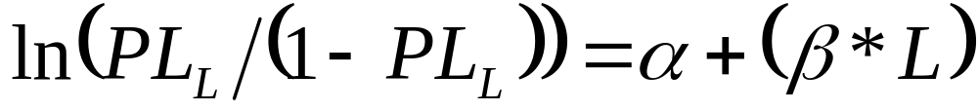
The terms α and β are determined using:
(1) Non-linear regression of data relating PL_{L} and L, or
(2) Linear regression of the linearized general form LCDF,

Slide 11
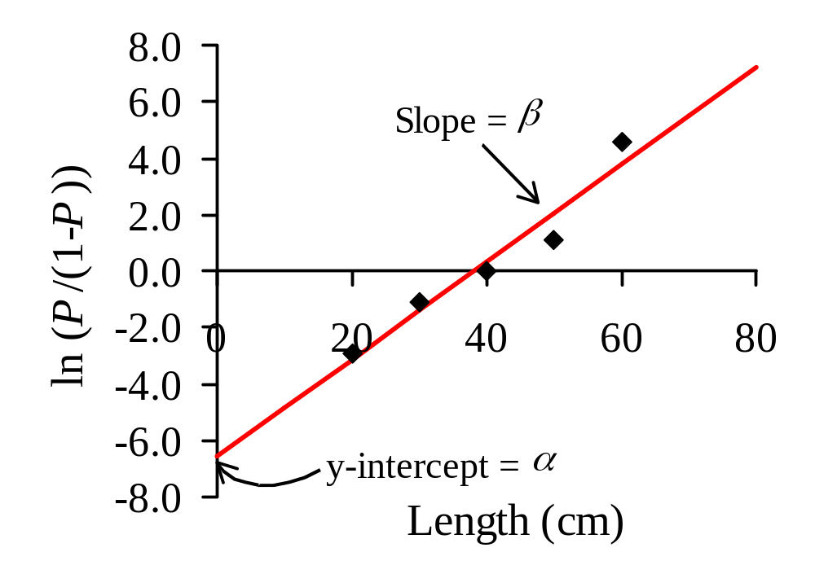
Regression of ln(PL_{L}/(1-PL_{L})) vs. L

Slide 12
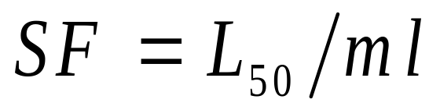
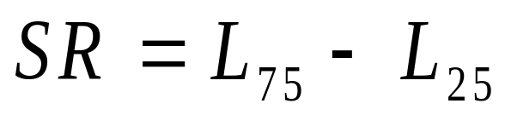
Other LCDF Parameters
Selection Factor (SF) is defined as:
where ml is the stretched mesh length.
Selection Range (SR) is a measure of the steepness of the LCDF curve, and is defined by:
where L₇₅ is the length at P = 0.75, and
L₂₅ is the length at P = 0.25.

Slide 13
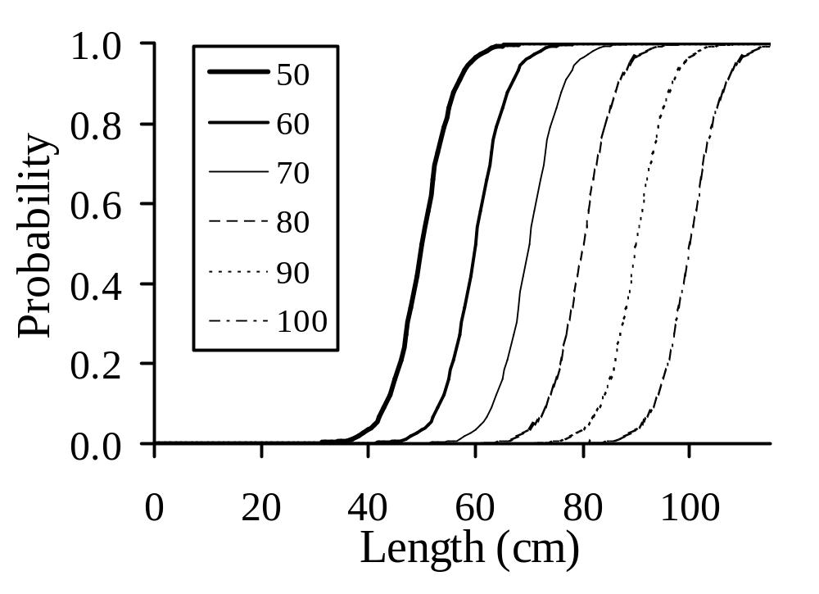
Logistic Cumulative Distribution Function (LCDF) Selectivity Curves.

Slide 14
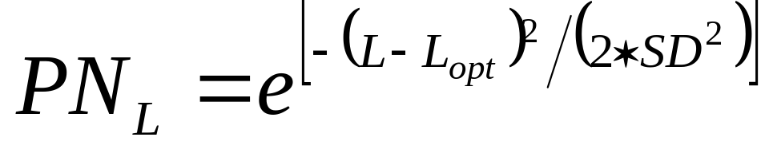
Normal Probability Distribution Function
    Where: PN_{L} is the probability of capture at length (L),
    SD is the standard deviation, and
L_{opt} is the length of maximum selection probability.

Slide 15
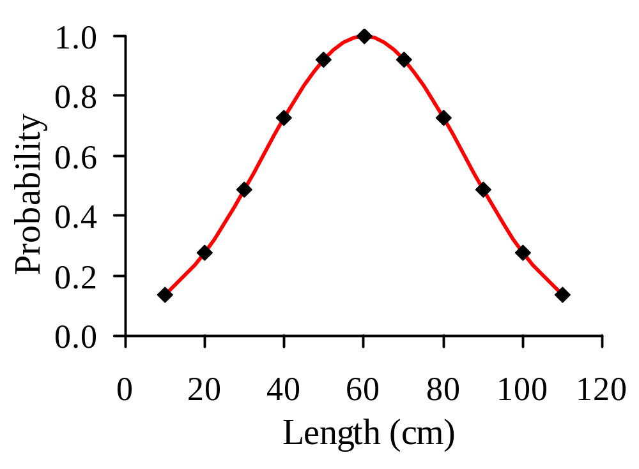
Probability of Selection Following a Normal Probability Distribution Function.

Slide 16
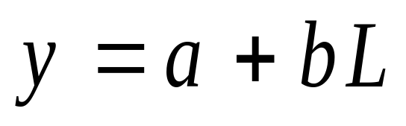
The terms L_{opt} and SD are determined by:
Comparing the catches of two similar gears with different mesh sizes (ml_{A} and ml_{B}) that overlap in L-F distributions:
Where y is the ln(C_{B}/C_{A}),
    a is the y-intercept, and
b is the slope.

Slide 17
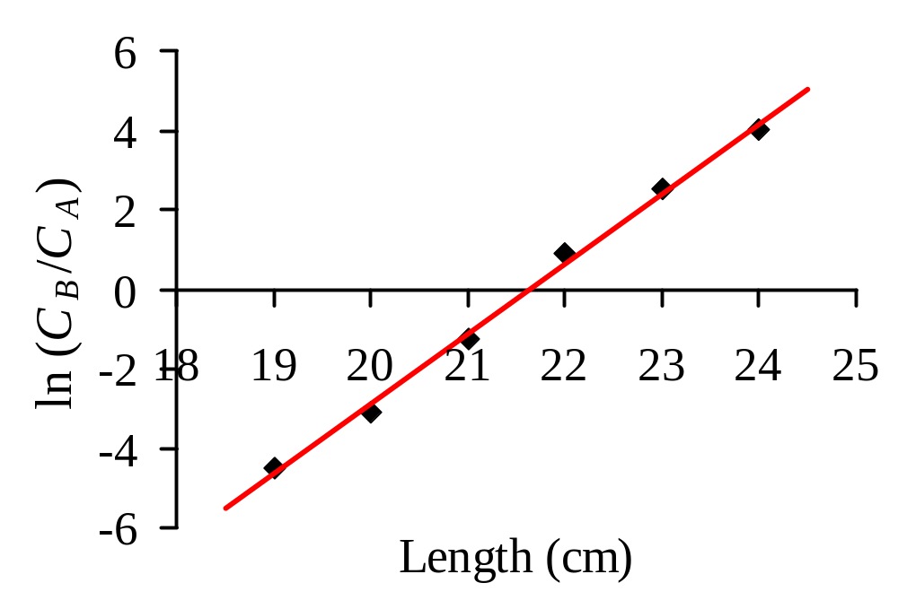
Linear regression of ln(C_{B}/C_{A}) for two similar gears that follow NPDF.

Slide 18
The terms L_{opt} and SD are determined by:
Lopt_{A}=-2*[(a*ml_{A})/(b*(ml_{A}+ml_{B}))]
Lopt_{B}=-2*[(a*ml_{B})/(b*(ml_{A}+ml_{B}))]
SD=[(-2*a*(ml_{A}-ml_{B}))/(b²*(ml_{A}+ml_{B}))]^{1/2}

Slide 19
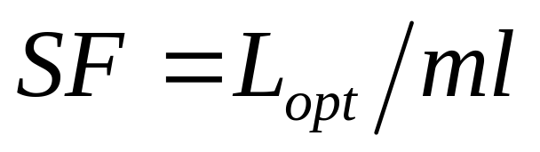
Other NPDF Parameters
Selection Factor (SF) is defined as:
where ml is the stretched mesh length.

Slide 20
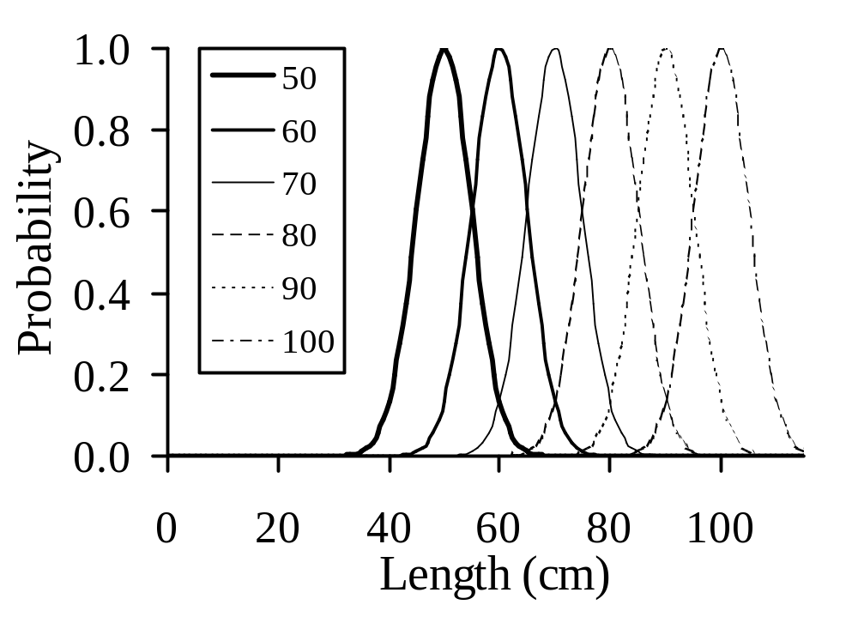
Logistic Cumulative Distribution Function (LCDF) Selectivity Curves.

Slide 21
Field Experiments for LCDF Trawl Size Selection Curves
Covered codend
Trouser trawl
Alternate paired tows

Slide 22
Analysis Methods for LCDF Trawl Size Selection Curves
Graphically
Linear Regression
Non-Linear Regression

Slide 23
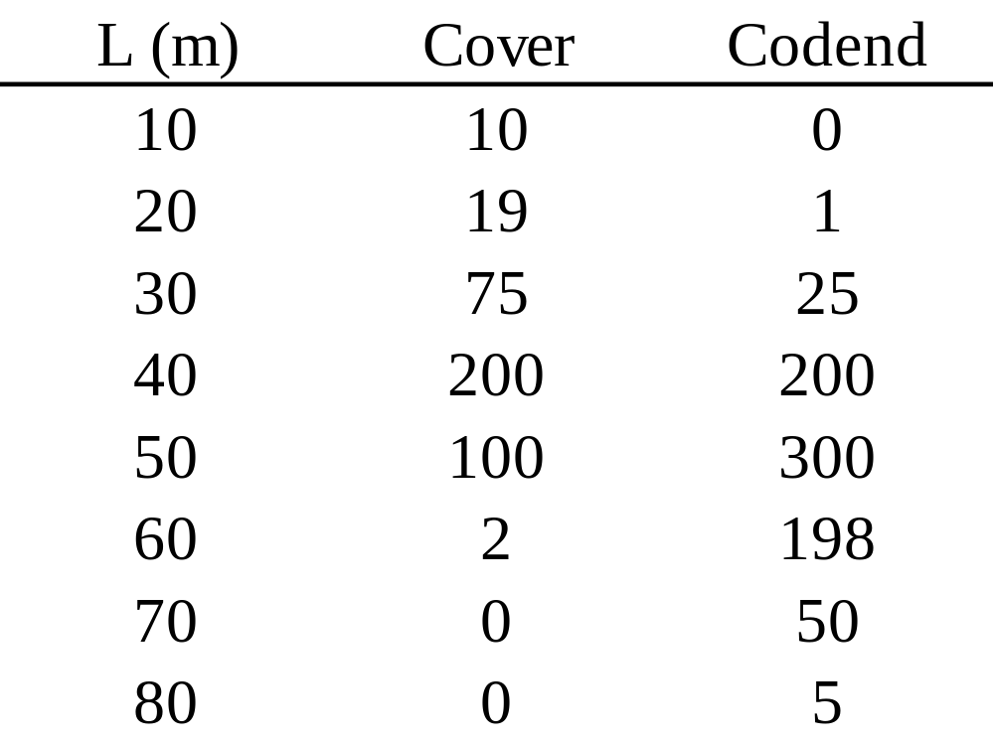
Covered Codend (12 cm, diamond mesh) Experiment for an Idealized Roundfish
Determine L₅₀, SF, and SR

Slide 24
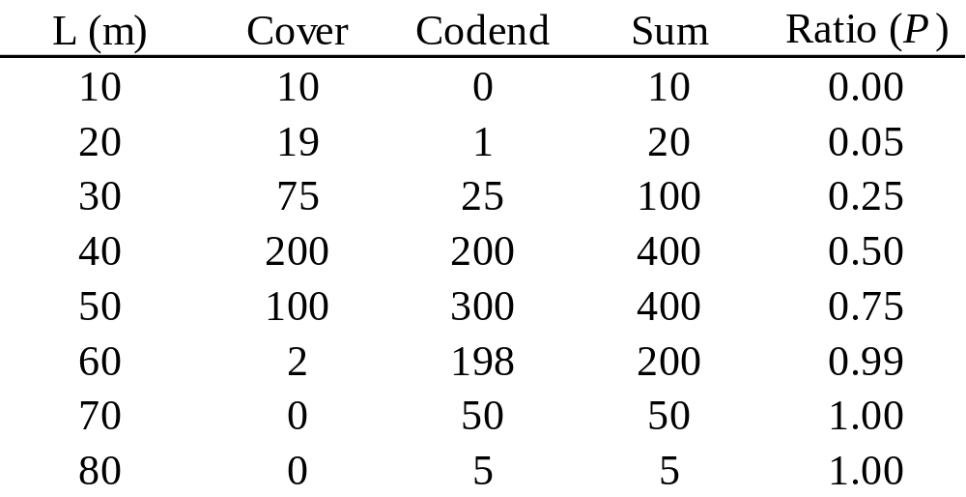
Graphic Solution Method: Data Analysis

Slide 25
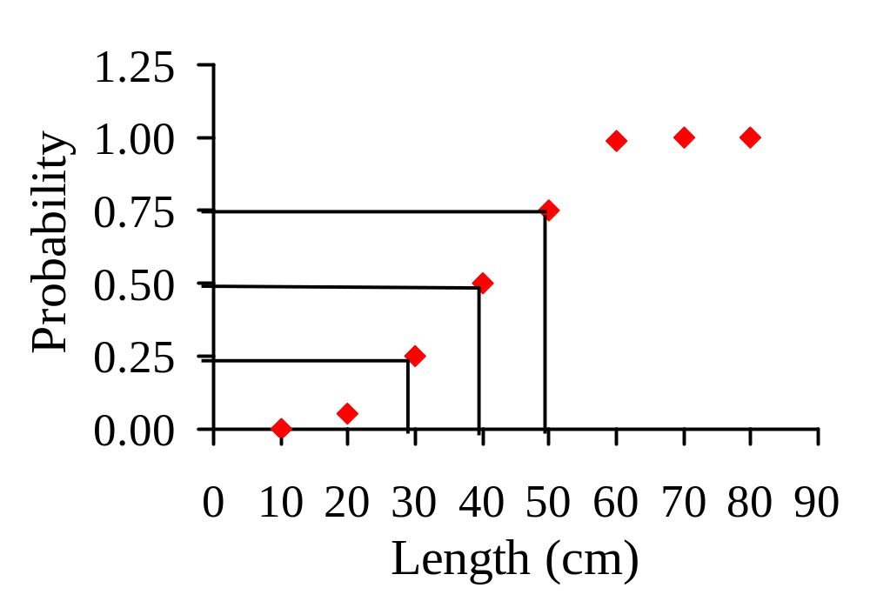
Graphic Solution Method: Plot

Slide 26
Graphic Solution Method: Result
L₅₀ = 40 cm
SF = L₅₀ / ml = 40 / 12 = 3.3
SR = L₇₅ - L₂₅ = 50 - 30 = 20

Slide 27
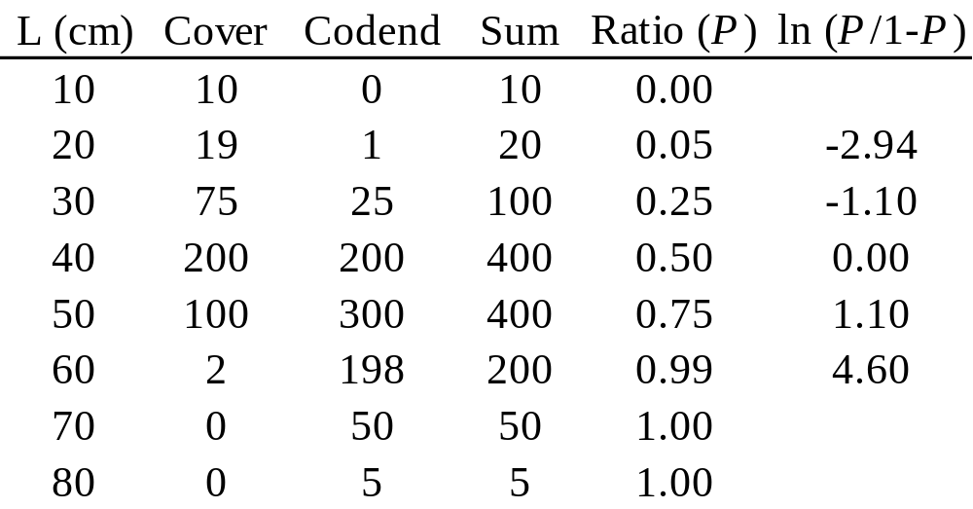
Linear Regression Method: Data Analysis

Slide 28
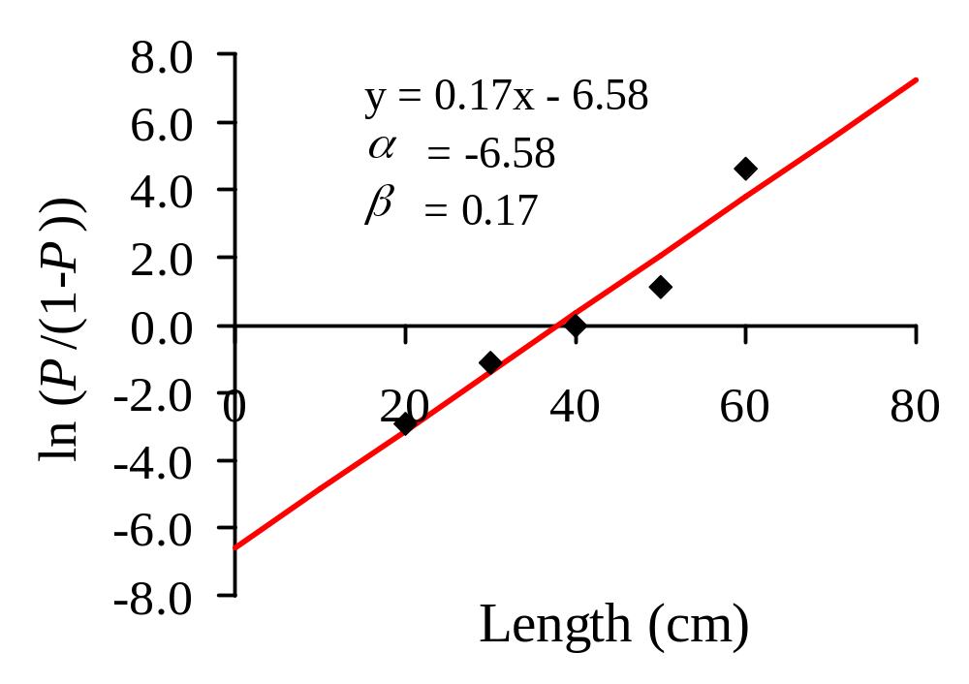
Linear Regression Analysis: Linear Plot

Slide 29
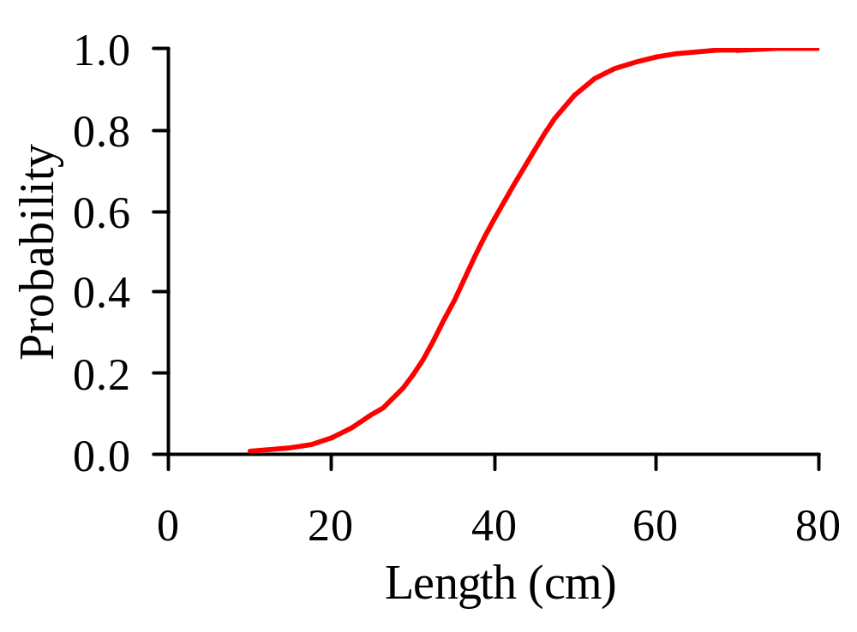
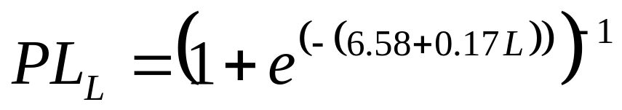
Linear Regression Analysis: Final Curve

Slide 30
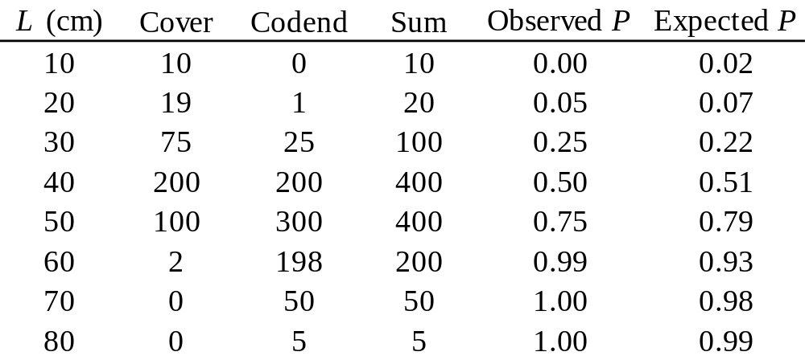
Non-Linear Regression Analysis: Specialized Form and Solver

Slide 31
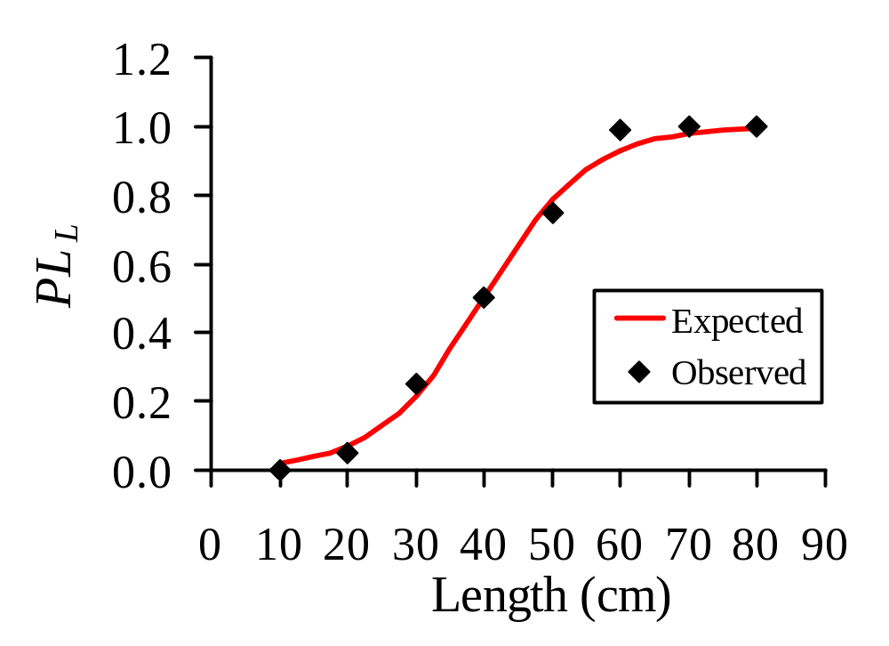
Non-Linear Regression Analysis: Final Curve

Slide 32
Field Experiments and Analysis Methods for NPDF Size Selection Curves
Using catch comparison technique.

Slide 33
Gillnet Catch Comparison Experiment for Two Nets
Nets A and B have catches and mesh sizes of 8.1 and 9.1 cm, respectively.
Determine the selection parameters a and b, the L_{opt}s for both nets, the standard deviation, and selection factor.
Plot the results using the NPDF model.

Slide 34
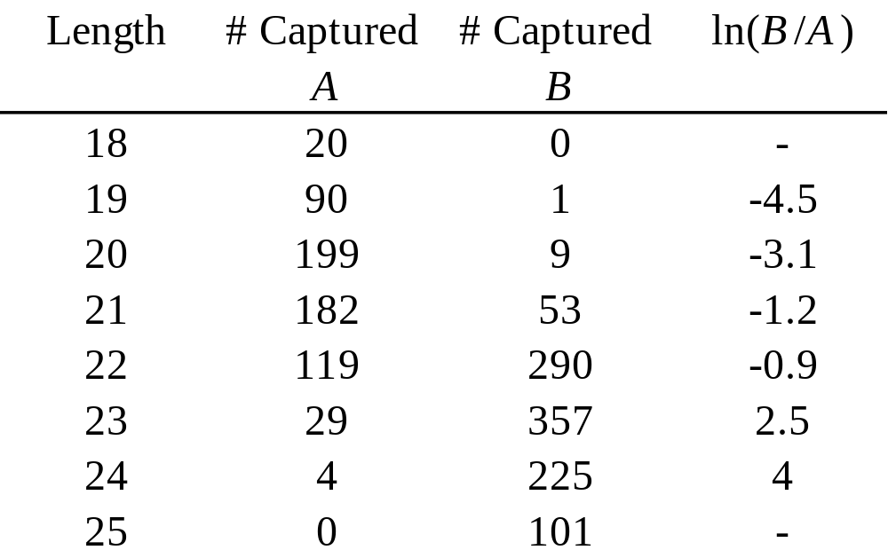
Catch Data

Slide 35
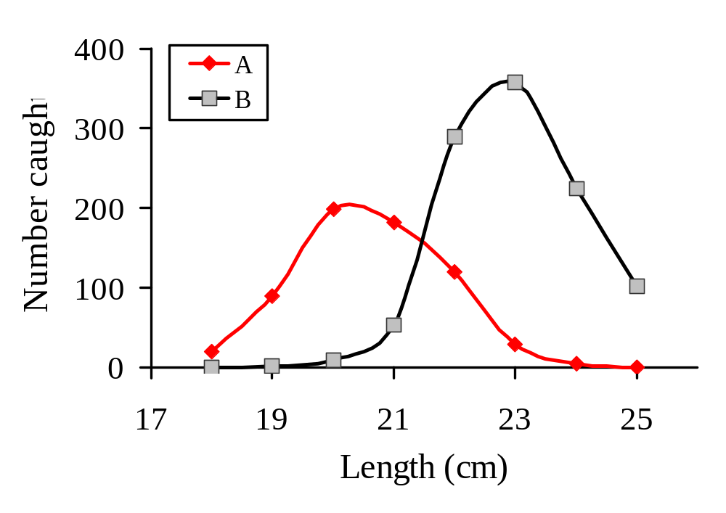
Length-Frequency Distribution of the Catches

Slide 36
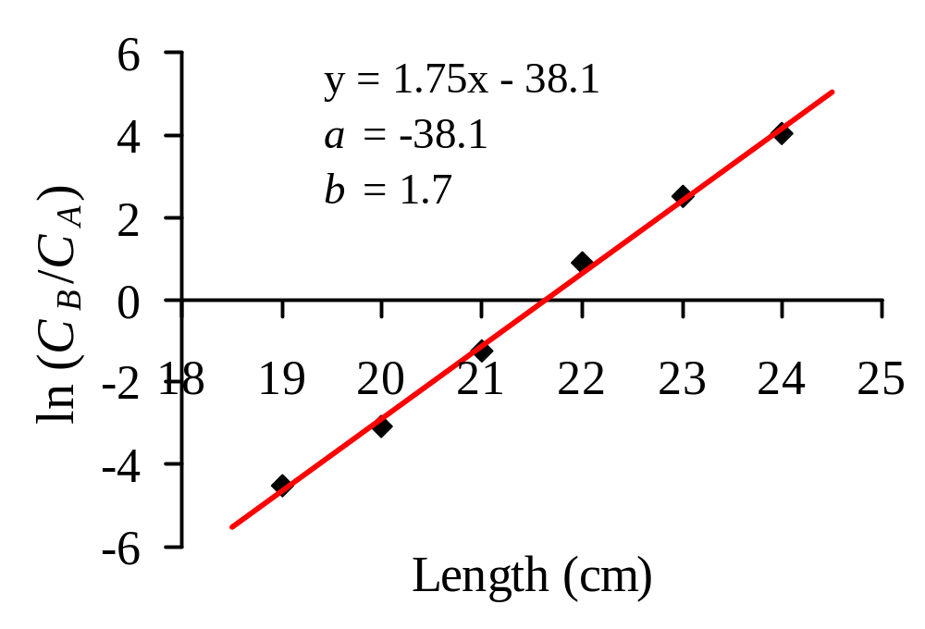
Plot of Natural Log of Catch Ratio [ln(C_{B}/C_{A})]

Slide 37
Calculation of L_{opt}A, L_{opt}B, and SD
L_{opt} A = -2 * [(a*ml_{A}) / (b*(ml_{A} + ml_{B}))]
= -2*((-38.07*8.1) / (1.76*(8.1+9.1)))
L_{opt} A = 20.37
L_{opt} B = -2 * [(a*ml_{B}) / (b * (ml_{A} + ml_{B}))]
= -2*((-38.07*9.1) / (1.76*(8.1+9.1)))
L_{opt} B = 22.89
SD = [-2*a*(ml_{B} - ml_{A}) / ((b²)*(ml_{A}) + ml_{B}))]
= [(-2*(-38.07)*(9.1-8.1)) / ((1.76)*(8.1+9.1))]^0.5
SD = 1.19

Slide 38
Calculation of Selection Factors
SF = L_{opt} / ml
SF_{A} = 20.37 / 8.1
SF_{A} = 2.52
SF_{B} = 22.89 / 9.1
SF_{B} = 2.52

Slide 39
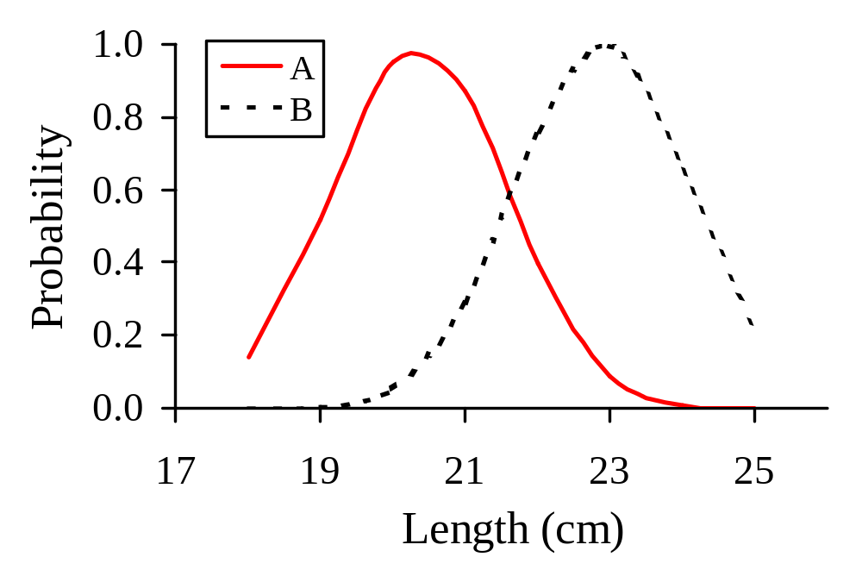
Gillnet Selection Curves
L_{opt}A
L_{opt}B

